Slide 1
Lecture 3 – CUDA Parallelism Model
CSD2170 Programming Massively Parallel Processors
Lecture 3.1 - Kernel-Based SPMD Parallel Programming

Slide 2
Objective
To learn the basic concepts involved in a simple CUDA kernel function
Declaration
Built-in variables
Thread index to data index mapping
2

Slide 3
Example: Vector Addition Kernel
Device Code
// Compute vector sum C = A + B
// Each thread performs one pair-wise addition
__global__
void vecAddKernel(float* A, float* B, float* C, int n)
{
int i = threadIdx.x+blockDim.x*blockIdx.x;
if(i<n) C[i] = A[i] + B[i];
}

Slide 4
Example: Vector Addition Kernel Launch (Host Code)
Host Code
void vecAdd(float* h_A, float* h_B, float* h_C, int n)
{
// d_A, d_B, d_C allocations and copies omitted
// Run ceil(n/256.0) blocks of 256 threads each
vecAddKernel<<<ceil(n/256.0),256>>>(d_A, d_B, d_C, n);
}
The ceiling function makes sure that there are enough threads to cover all elements.
4

Slide 5
More on Kernel Launch (Host Code)
Host Code
void vecAdd(float* h_A, float* h_B, float* h_C, int n)
{
dim3 DimGrid((n-1)/256 + 1, 1, 1);
dim3 DimBlock(256, 1, 1);
vecAddKernel<<<DimGrid,DimBlock>>>(d_A, d_B, d_C, n);
}
This is an equivalent way to express the ceiling function.

Slide 6
Kernel execution in a nutshell
__host__
void vecAdd(…)
{
dim3 DimGrid(ceil(n/256.0),1,1);
dim3 DimBlock(256,1,1);
vecAddKernel<<<DimGrid,DimBlock>>>(d_A,d_B,d_C,n);
}
__global__
void vecAddKernel(float *A,
float *B, float *C, int n)
{
int i = blockIdx.x * blockDim.x
+ threadIdx.x;
if( i<n ) C[i] = A[i]+B[i];
}
Blk 0
Grid
Blk N-1
• • •
GPU
M0
• • •
Mk
RAM

Slide 7
More on CUDA Function Declarations
Executed on the:
Only callable from the:
__device__ float DeviceFunc()‏
device
device
__global__ void KernelFunc()‏
device
host
__host__ float HostFunc()‏
host
host
__global__ defines a kernel function
Each “__” consists of two underscore characters
A kernel function must return void
__device__ and __host__ can be used together
__host__ is optional if used alone

Slide 8
Compiling A CUDA Program
Integrated C programs with CUDA extensions
NVCC Compiler
Host Code
Device Code (PTX)
Host C Compiler/ Linker
Device Just-in-Time Compiler
Heterogeneous Computing Platform with
CPUs, GPUs, etc.

Slide 9
Lecture 3 – CUDA Parallelism Model
CSD2170 Programming Massively Parallel Processors
Lecture 3.2 - Multidimensional Kernel Configuration

Slide 10
Objective
To understand multidimensional Grids
Multi-dimensional block and thread indices
Mapping block/thread indices to data indices
2

Slide 11
A Multi-Dimensional Grid Example
host
device
Grid 1
Block (0, 0)
Block (0, 1)
Kernel 1
Block (1, 0)
Block (1, 1)
Block (1,0)
Grid 2
(1,0,0)
(1,0,1)
(1,0,2)
(1,0,3)
Thread
(0,0,0)
Thread
(0,0,1)
Thread
(0,0,2)
Thread
(0,0,3)
Thread
(0,0,0)
Thread
(0,1,3)
Thread
(0,1,0)
Thread
(0,1,1)
Thread
(0,1,2)
11

Slide 13
Row-Major Layout in C/C++
M
Row*Width+Col = 2*4+1 = 9
M₀
M₁
M₂
M₃
M₄
M₅
M₆
M₇
M₈
M₉
M₁₀
M₁₁
M₁₂
M₁₃
M₁₄
M₁₅
M
M_{0,0}
M_{0,1}
M_{0,2}
M_{0,3}
M_{1,0}
M_{1,1}
M_{1,2}
M_{1,3}
M_{2,0}
M_{2,1}
M_{2,2}
M_{2,3}
M_{3,0}
M_{3,1}
M_{3,2}
M_{3,3}
M_{0,0}
M_{0,1}
M_{0,2}
M_{0,3}
M_{1,0}
M_{1,1}
M_{1,2}
M_{1,3}
M_{2,0}
M_{2,1}
M_{2,2}
M_{2,3}
M_{3,0}
M_{3,1}
M_{3,2}
M_{3,3}

Slide 14
Source Code of a PictureKernel
__global__ void PictureKernel(float* d_Pin, float* d_Pout,
int height, int width)
{
// Calculate the row # of the d_Pin and d_Pout element
int Row = blockIdx.y*blockDim.y + threadIdx.y;
// Calculate the column # of the d_Pin and d_Pout element
int Col = blockIdx.x*blockDim.x + threadIdx.x;
// each thread computes one element of d_Pout if in range
if ((Row < height) && (Col < width)) {
d_Pout[Row*width+Col] = 2.0*d_Pin[Row*width+Col];
}
}
Scale every pixel value by 2.0

Slide 15
Host Code for Launching PictureKernel
// assume that the picture is m$×$n,
// m pixels in y dimension and n pixels in x dimension
// input d_Pin has been allocated on and copied to device
// output d_Pout has been allocated on device
…
dim3 DimGrid((n-1)/16 + 1, (m-1)/16+1, 1);
dim3 DimBlock(16, 16, 1);
PictureKernel<<<DimGrid,DimBlock>>>(d_Pin, d_Pout, m, n);
…

Slide 16
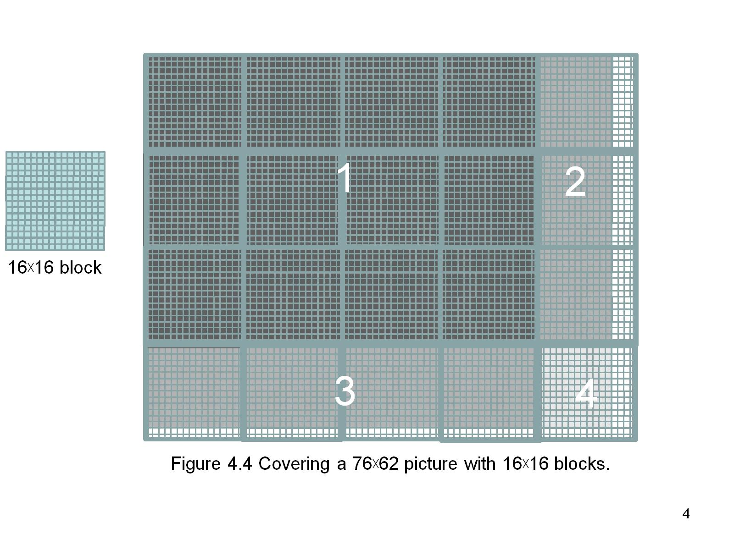
Covering a 62$×$76 Picture with 16$×$16 Blocks
Not all threads in a Block will follow the same control flow path.

Slide 17
Lecture 3 – CUDA Parallelism Model
CSD2170 Programming Massively Parallel Processors
Lecture 3.3 - Color-to-Grayscale Image Processing Example

Slide 18
Objective
To gain deeper understanding of multi-dimensional grid kernel configurations through a real-world use case
2

Slide 19
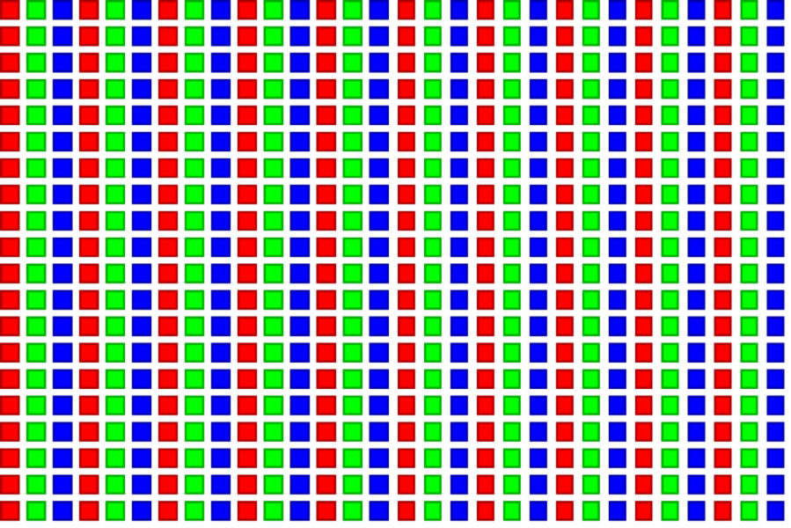
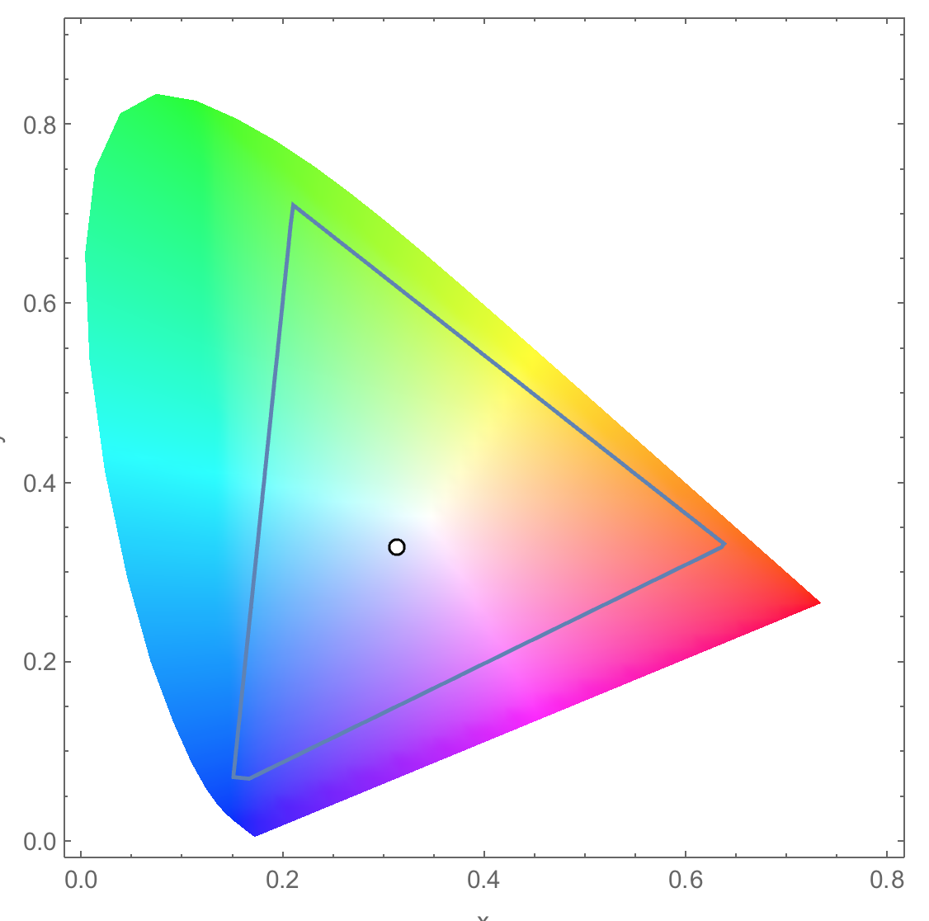
RGB Color Image Representation
Each pixel in an image is an RGB value
The format of an image’s row is (r g b) (r g b) … (r g b)
RGB ranges are not distributed uniformly
Many different color spaces, here we show the constants to convert to AdobeRGB color space
The vertical axis (y value) and horizontal axis (x value) show the fraction of the pixel intensity that should be allocated to G and B. The remaining fraction (1-y–x) of the pixel intensity that should be assigned to R
The triangle contains all the representable colors in this color space

Slide 20


RGB to Grayscale Conversion
A grayscale digital image is an image in which the value of each pixel carries only intensity information.

Slide 21
Color Calculating Formula
For each pixel (r g b) at (I, J) do: grayPixel[I,J] = 0.21*r + 0.71*g + 0.07*b
This is just a dot product <[r,g,b],[0.21,0.71,0.07]> with the constants being specific to input RGB space
0.71
0.21
0.07

Slide 22
RGB to Grayscale Conversion Code
#define CHANNELS 3 // we have 3 channels corresponding to RGB
// The input image is encoded as unsigned characters [0, 255]
__global__ void colorConvert(unsigned char * grayImage,
unsigned char * rgbImage,
int width, int height) {
int x = threadIdx.x + blockIdx.x * blockDim.x;
int y = threadIdx.y + blockIdx.y * blockDim.y;
if (x < width && y < height) {
// get 1D coordinate for the grayscale image
int grayOffset = y*width + x;
// one can think of the RGB image having
// CHANNEL times columns than the gray scale image
int rgbOffset = grayOffset*CHANNELS;
unsigned char r = rgbImage[rgbOffset ]; // red value for pixel
unsigned char g = rgbImage[rgbOffset + 2]; // green value for pixel
unsigned char b = rgbImage[rgbOffset + 3]; // blue value for pixel
// perform the rescaling and store it
// We multiply by floating point constants
grayImage[grayOffset] = 0.21f*r + 0.71f*g + 0.07f*b;
}
}

Slide 23
RGB to Grayscale Conversion Code
#define CHANNELS 3 // we have 3 channels corresponding to RGB
// The input image is encoded as unsigned characters [0, 255]
__global__ void colorConvert(unsigned char * grayImage,
unsigned char * rgbImage,
int width, int height) {
int x = threadIdx.x + blockIdx.x * blockDim.x;
int y = threadIdx.y + blockIdx.y * blockDim.y;
if (x < width && y < height) {
// get 1D coordinate for the grayscale image
int grayOffset = y*width + x;
// one can think of the RGB image having
// CHANNEL times columns than the gray scale image
int rgbOffset = grayOffset*CHANNELS;
unsigned char r = rgbImage[rgbOffset ]; // red value for pixel
unsigned char g = rgbImage[rgbOffset + 1]; // green value for pixel
unsigned char b = rgbImage[rgbOffset + 2]; // blue value for pixel
// perform the rescaling and store it
// We multiply by floating point constants
grayImage[grayOffset] = 0.21f*r + 0.71f*g + 0.07f*b;
}
}

Slide 24
RGB to Grayscale Conversion Code
#define CHANNELS 3 // we have 3 channels corresponding to RGB
// The input image is encoded as unsigned characters [0, 255]
__global__ void colorConvert(unsigned char * grayImage,
unsigned char * rgbImage,
int width, int height) {
int x = threadIdx.x + blockIdx.x * blockDim.x;
int y = threadIdx.y + blockIdx.y * blockDim.y;
if (x < width && y < height) {
// get 1D coordinate for the grayscale image
int grayOffset = y*width + x;
// one can think of the RGB image having
// CHANNEL times columns than the gray scale image
int rgbOffset = grayOffset*CHANNELS;
unsigned char r = rgbImage[rgbOffset ]; // red value for pixel
unsigned char g = rgbImage[rgbOffset + 1]; // green value for pixel
unsigned char b = rgbImage[rgbOffset + 2]; // blue value for pixel
// perform the rescaling and store it
// We multiply by floating point constants
grayImage[grayOffset] = 0.21f*r + 0.71f*g + 0.07f*b;
}
}

Slide 25
Lecture 3 – CUDA Parallelism Model
CSD2170 Programming Massively Parallel Processors
Lecture 3.4 - Image Blur Example

Slide 26
Objective
To learn a 2D kernel with more complex computation and memory access patterns

Slide 27

Image Blurring

Slide 29
Image Blur as a 2D Kernel
__global__
void blurKernel(unsigned char * in, unsigned char * out, int w, int h)
{
int Col = blockIdx.x * blockDim.x + threadIdx.x;
int Row = blockIdx.y * blockDim.y + threadIdx.y;
if (Col < w && Row < h) {
... // Rest of our kernel
}
}

Slide 30
__global__
void blurKernel(unsigned char * in, unsigned char * out, int w, int h) {
int Col = blockIdx.x * blockDim.x + threadIdx.x;
int Row = blockIdx.y * blockDim.y + threadIdx.y;
if (Col < w && Row < h) {
int pixVal = 0;
int pixels = 0;
// Get the average of the surrounding 2xBLUR_SIZE x 2xBLUR_SIZE box
for(int blurRow = -BLUR_SIZE; blurRow < BLUR_SIZE+1; ++blurRow) {
for(int blurCol = -BLUR_SIZE; blurCol < BLUR_SIZE+1; ++blurCol) {
int curRow = Row + blurRow;
int curCol = Col + blurCol;
// Verify we have a valid image pixel
if(curRow > -1 && curRow < h && curCol > -1 && curCol < w) {
pixVal += in[curRow * w + curCol];
pixels++; // Keep track of number of pixels in the accumulated total
}
}
}
// Write our new pixel value out
out[Row * w + Col] = (unsigned char)(pixVal / pixels);
}
}

Slide 31
Lecture 3 – CUDA Parallelism Model
CSD2170 Programming Massively Parallel Processors
Lecture 3.5 - Thread Scheduling

Slide 32
Objective
To learn how a CUDA kernel utilizes hardware execution resources
Assigning thread blocks to execution resources
Capacity constraints of execution resources
Zero-overhead thread scheduling

Slide 33
Transparent Scalability
Device
Device
Thread grid
Block 0
Block 1
Block 2
Block 3
Block 0
Block 1
Block 2
Block 3
Block 0
Block 1
time
Block 4
Block 5
Block 2
Block 3
Block 6
Block 7
Block 4
Block 5
Block 6
Block 7
Block 4
Block 5
Block 6
Block 7
Each block can execute in any order relative to others.
Hardware is free to assign blocks to any processor at any time
A kernel scales to any number of parallel processors

Slide 34
Example: Executing Thread Blocks
SM
t0 t1 t2 … tm
Threads are assigned to Streaming Multiprocessors (SM) in block granularity
Up to 8 blocks to each SM as resource allows
Fermi SM can take up to 1536 threads
Could be 256 (threads/block) * 6 blocks
Or 512 (threads/block) * 3 blocks, etc.
SM maintains thread/block idx #s
SM manages/schedules thread execution
SP
Blocks
Shared
Memory

Slide 35
The Von-Neumann Model
Memory
I/O
Processing Unit
Reg
File
ALU
Control Unit
PC
IR
Notes:
Insert von-neumann schematic here

Slide 36
The Von-Neumann Model with SIMD units
Memory
I/O
Processing Unit
Reg
File
ALU
Control Unit
PC
IR
Single Instruction Multiple Data
(SIMD)
Notes:
Insert von-neumann schematic here

Slide 37
Warps as Scheduling Units
Each Block is executed as 32-thread Warps
An implementation decision, not part of the CUDA programming model
Warps are scheduling units in SM
Threads in a warp execute in SIMD
Future GPUs may have different number of threads in each warp

Slide 38
Warp Example
If 3 blocks are assigned to an SM and each block has 256 threads, how many Warps are there in an SM?
Each Block is divided into 256/32 = 8 Warps
There are 8 * 3 = 24 Warps
…
Block 0 Warps
…
Block 1 Warps
…
…
…
Block 2 Warps
…
t0 t1 t2 … t31
t0 t1 t2 … t31
t0 t1 t2 … t31
Register File
L1
Shared Memory

Slide 39
Example: Thread Scheduling (Cont.)
SM implements zero-overhead warp scheduling
Warps whose next instruction has its operands ready for consumption are eligible for execution
Eligible Warps are selected for execution based on a prioritized scheduling policy
All threads in a warp execute the same instruction when selected

Slide 40
Block Granularity Considerations
For Matrix Multiplication using multiple blocks, should I use 8X8, 16X16 or 32X32 blocks for Fermi?
For 8X8, we have 64 threads per Block. Since each SM can take up to 1536 threads, which translates to 24 Blocks. However, each SM can only take up to 8 Blocks, only 512 threads will go into each SM!
For 16X16, we have 256 threads per Block. Since each SM can take up to 1536 threads, it can take up to 6 Blocks and achieve full capacity unless other resource considerations overrule.
For 32X32, we would have 1024 threads per Block. Only one block can fit into an SM for Fermi. Using only 2/3 of the thread capacity of an SM.

